Slide 1
SCC331 group 5 (super coders) user testing
SPRINT 6

Slide 2
REASONS FOR OUR RESEARCH
We are thrilled to share the findings from our user testing research for the webpage and app for scc311 group 5 project sprint 6. to release our project We must do extensive user testing to improve the overall usability and functioning of our webpage and app. The purpose of this research is to evaluate the efficacy of different features and design aspects, collect user input, and identify and address potential usability issues. We may obtain important insights into our target audience's preferences, problems, and expectations by including them in the testing process. This will help us make well-informed judgments about how best to optimize the user interface and user journey as a whole. In the end, this research helps to guarantee that our webpage and app not only meet but also beyond user expectations, creating a more engaging and user-friendly digital platform

Slide 3

Research findings:
Six people who had not contributed to the webspage or app's previous development were gathered. They were instructed to utilize the webpage/app and answer ten questions with five choices so that we could draw our conclusions. We also collected six more distinct people for the website and application.

Slide 4
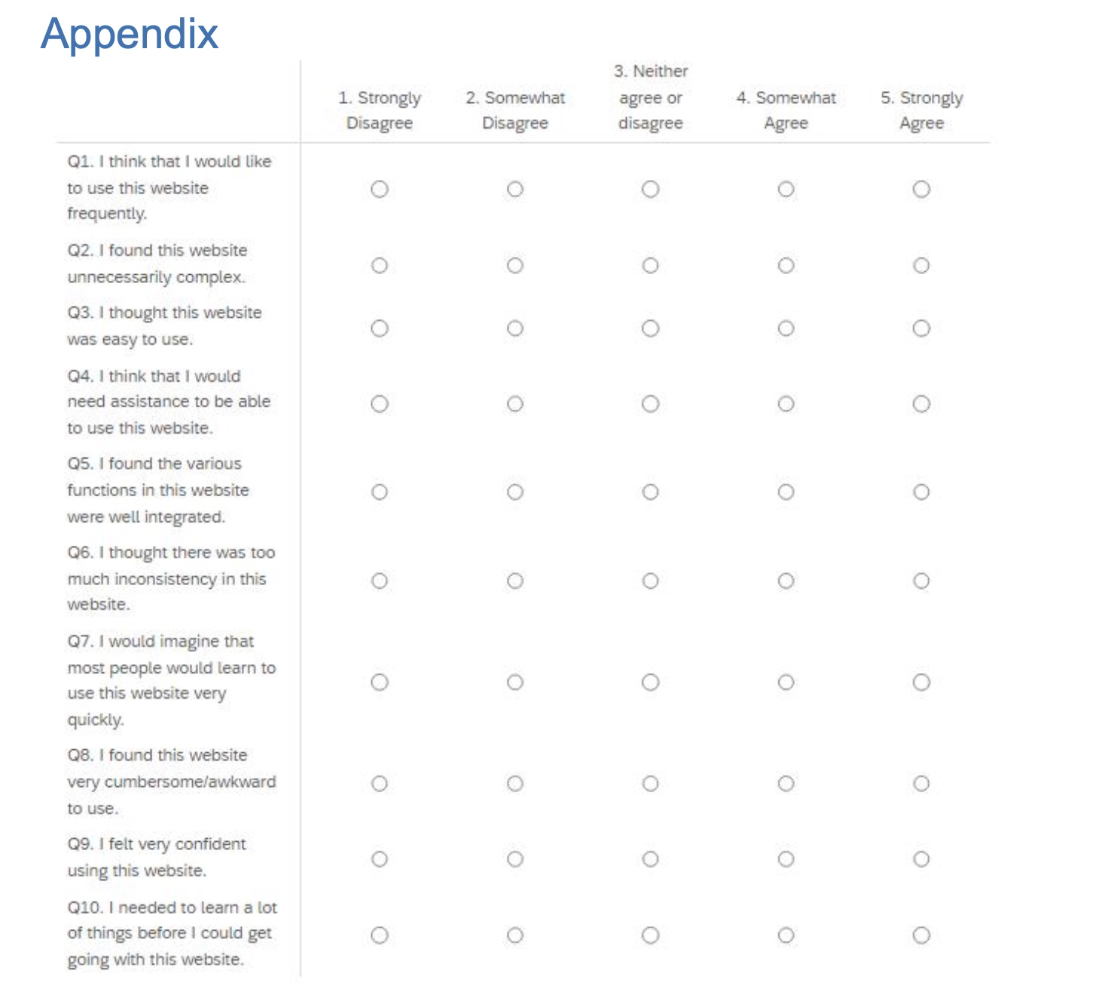

Slide 5
WEBPAGE USER ANSWERS
 | USER 1 | USER 2 | USER 3 | USER 4 | USER 5 | USER 6
QUESTION 1 | 5 | 4 | 4 | 4 | 5 | 3
QUESTION 2 | 2 | 1 | 3 | 1 | 2 | 2
QUESTION 3 | 3 | 5 | 5 | 4 | 4 | 3
QUESTION 4 | 1 | 1 | 1 | 1 | 1 | 2
QUESTION 5 | 4 | 4 | 4 | 5 | 5 | 3
QUESTION 6 | 1 | 1 | 2 | 1 | 1 | 3
QUESTION 7 | 5 | 4 | 5 | 3 | 3 | 5
QUESTION 8 | 1 | 1 | 2 | 1 | 2 | 1
QUESTION 9 | 4 | 4 | 5 | 5 | 4 | 5
QUESTION 10 | 1 | 1 | 2 | 1 | 1 | 1
AVERAGE
4
2
4
1
4
2
4
2
5
2

Slide 6
APP ANSWERS
 | USER 1 | USER 2 | USER 3 | USER 4 | USER 5 | USER 6 | AVERAGE
QUESTION 1 | 4 | 4 | 5 | 5 | 3 | 4 | 4
QUESTION 2 | 2 | 1 | 3 | 1 | 1 | 1 | 2
QUESTION 3 | 4 | 4 | 5 | 3 | 3 | 4 | 4
QUESTION 4 | 1 | 1 | 3 | 2 | 2 | 1 | 2
QUESTION 5 | 5 | 4 | 4 | 4 | 4 | 5 | 5
QUESTION 6 | 1 | 3 | 1 | 2 | 2 | 1 | 2
QUESTION 7 | 3 | 4 | 5 | 3 | 4 | 4 | 4
QUESTION 8 | 1 | 1 | 1 | 2 | 1 | 2 | 2
QUESTION 9 | 5 | 5 | 4 | 4 | 4 | 5 | 4
QUESTION 10 | 1 | 1 | 2 | 3 | 1 | 3 | 2

Slide 7
APP QUESTION RATINGS

Slide 8
WEBPAGE RATINGS

Slide 9
There were six respondents and they were asked to rate the app/webpage On a scale of 1 to 5, where 5 denoted complete functionality and 1 meant barely usable app/webpage. I completed an additional feedback box based on user responses after each survey when interviewing the participants. The following is the rating that each participant provided:
APP RATING

Slide 10
webpage rating

Slide 11

CONCLUSION
The vast majority of participant feedback emphasizes the advantages of our platform, confirming the effort and commitment that went into its creation. The user-friendly interface's smooth navigation, intuitive design, and general usability were frequently complimented by users. Seeing the good effects of our work on the user experience makes me very happy. The elements that proved to be successful in the testing process not only validate our present course but also instill trust in our capacity to fulfill and surpass user expectations. We have learned a great deal from our thorough user testing of the group 5 webpage/app, and these insights will greatly improve the overall user experience. Several factors were considered during the evaluation process, such as task success, error rates, user happiness, usability, and time spent on the work. The majority of participants expressed satisfaction with the webpage/app and claimed that the navigation, design, and layout of the website were user-friendly. The results of this user testing will help us prioritize and carry out the required changes. We pledge to improve the super programmers (group 5) website/app in order to exceed customer expectations and provide a first-rate user experience. Additional testing, continuous incorporation of feedback, and design modifications are examples of iterative processes.We value the substantial contributions made by all participants and users, including testers and visitors to the hotel, and we're excited to implement these changes to improve the Super Coders website and app even further for our users.

Slide 12

ETHICAL CONSIDERATIONS
Options for feedback and continuous communication were implemented during the user testing process to address any problems or discomfort participants may have experienced. In addition, we employed tactics to reduce the possibility of biases in the testing environment. For example, we ensured that participant responses were not influenced by remarks made throughout the test, maintaining fairness and equal opportunities for all participants. For this sprint, ethical considerations like privacy were taken way more seriously as this involved a hotel system involving guests who are first-class citizens with all their citizenship rights compared to the prison system where prisoners are being monitored. During user testing, the ethical framework served as a compass, emphasizing the value of user convenience, trust, confidence, and privacy. Ultimately, this encouraged a more responsible and meticulous development process for the app and homepage. The user testing research was also disclosed to Lancaster University's teaching office, and I eventually received approval from the module convenor, Mrs. Tracy Hall. The entire process of developing and creating the app and webpage was heavily influenced by ethical issues, particularly in the user testing stage. To ensure an open and polite approach, informed consent was carefully acquired from each participant, detailing the nature of their involvement and the data we would gather. Anonymization of user data was the main objective behind the implementation of strict privacy safeguards. We emphasized the construction of a privacy framework because we recognized that, as a smart system, the prison/hotel system may give rise to privacy concerns and data misuse. We tried to maintain a varied and inclusive participant pool, but we limited the age range to those between the ages of 18 and 22 because we understood the importance of representative opinion. On the webpage, we also added an MFA code for extra security measures incase an unauthorized person wants to access an account

